Slide 1
Test & Control

Slide 2
1. Basics and 1 to 1 Matching

Slide 3
Test and Control - Topics
Experimental Design vs Retrospective Analysis
One to One Matching – Fundamentals
One to One Matching - Details
Definitions
Calendar View
Sample Data
Time Alignment
Matching 1:1
Lift and ROI Calculations
Basic Delta
Regression – Accounting for Post Period Covariates
Outputs and Charts
Propensity Scores
Synthetic Controls
Discussions on HealthMap / PromoCON Net Conversions

Slide 4
Introduction and Experimental Design
Objective: Measure the lift from an event by comparing the outcomes from event participants (Test) against similar participants who are like the event participants but DID NOT participate in the event (Control). Example: Speaker Program (Merck Managed Forums – MMF)
Experimental Design
A randomized pilot is planned apriori to the event and Test and Control groups are compared after the event takes place.
Various forms of experimental designs exist. This is GOLD STANDARD method of Lift Measurement.
Often difficult to plan and implement due to various market conditions and Marketing activities. Sponorship from brand teams are relatively difficult.

Slide 5
Retrospective Analysis
Retrospective Analysis
Analysis is carried out by picking controls after the event has concluded.
Hard to maintain randomization and measurement becomes biased based on how well we can get controls.
Easy to implement as rigorous initial pilot planning is not needed
Multiple ways to pick Controls:
Random groups or Segmented groups – simple but often not similar to Test group
Matched Controls – Pick controls by explicitly matching with Test candidates on selected variables. Most common is 1:1 matching.
Propensity Scores – Large number of variables used for matching
Synthetic Controls – Recent advancement in the field. A Test participant is matched against multiple Control participants in fractional basis.

Slide 6
One to One Matching of Test and Controls

Slide 7
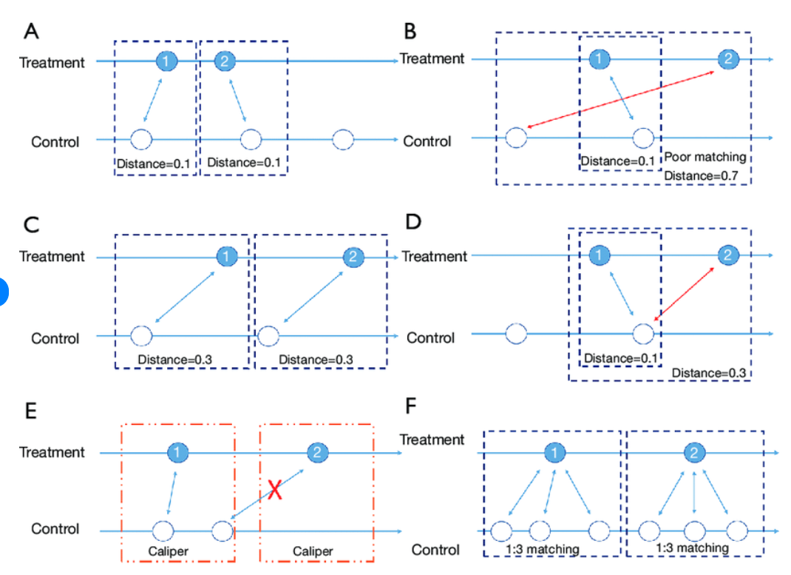
One to One Matching
Objective: For each Test participant, find a Control participant by explicitly matching using defined set of variables and pick the most similar Control candidate from a pool of potential control participants. Then compare the outcome from each pair and aggregate them to get overall lift.
Image from:
https://www.researchgate.net/figure/llustration-and-comparison-of-different-matching-methods-In-every-subfigure-blue_fig2_349096125

Slide 8
Matching by Example - Event: Speaker Program [MMF] - Definitions
Time Periods
Data Time Period | 15 Months | Jan 22 to Mar 23
Analysis Period | 6 Months | Jul 22 to Dec 22
Event Month | Month of First Exposure within Analysis Period (Jul 22 to Dec 22)
Post Period | 6 Months from Event Month (including Event Month). If enough months of data is not available, then post month is upto end of data availability (Mar 23)
Pre Period | 6 months prior to Event Month (not including event month)
Data
2 Test Candidates, 10 Control Pool Candidates.
Level - Candidate x Month
Variables - "Y" is the variable to measure lift in post period. X1 to X3 are variables to match in pre-period.

Slide 9
Calendar

Slide 10
Data – Test Candidates (T1, T2)

Slide 11
Data – Control Pool Candidates (CP1 to CP10)
Note: Control Pool don’t have any events

Slide 12
Matching Variables – Variables to look for similarities between Test and Control Candidates in the Pre-Period
Categorical
Specialty – Primary Care (PCP), Specialists (SP)
Continuous
Y (NRx) – Pre-Period Total
Y (NRx) during 1st month before Event – Y at -1
Y (NRx) during 2nd month before Event – Y at -2
Y (NRx) during 3rd month before Event – Y at -3
X1 (Details) – Pre-Period Total
X2 (Samples) – Pre-Period Total
X3 (NPP Engagements) – Pre-Period Total

Slide 13
Time Alignment – Test Candidate 1 (T1)
Since T1 is a PCP, choose all PCP Control Potentials for further analysis – Strict Matching by Categorical Variable(s)
Identify Pre and Post Periods and Time align all candidates.
T1 Pre Period (6 months) – Jan 22 to Jun 22
T1 Post Period (6 months) – Jul 22 to Dec 22
Retain only Pre and Post Periods
We have 5 control pool candidates to match against (CP1 to CP5)

Slide 14
Time Alignment – Test Candidate 1 (T2)
Since T2 is a SP, choose all SP Control Potentials for further analysis – Strict Matching by Categorical Variable(s)
Identify Pre and Post Periods and Time align all candidates.
T2 Pre Period (6 months) – May 22 to Oct 22
T2 Post Period (5 months) – Nov 22 to Mar 23
Retain only Pre and Post Periods
We have 5 control pool candidates to match against (CP6 to CP10)

Slide 15
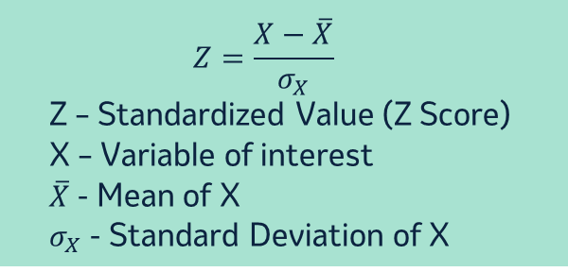
Matching – T1
Compute Matching Vars
Y (NRx) – Pre-Period Total
Y (NRx) during 1st month before Event – Y at -1
Y (NRx) during 2nd month before Event – Y at -2
Y (NRx) during 3rd month before Event – Y at -3
X1 (Details) – Pre-Period Total
X2 (Samples) – Pre-Period Total
X3 (NPP Engagements) – Pre-Period Total
Standardize
$$Z=\frac{X−\overline{X}}{σ_{X}}$$
Z – Standardized Value (Z Score)
X – Variable of interest
$\overline{X}$ - Mean of X
$σ_{X}$ - Standard Deviation of X

Slide 16
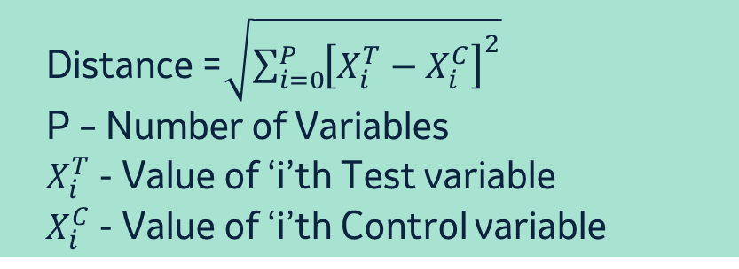
Matching – T1 and CP5 are matched Test and Control Pair
Compute Standardized Euclidean Distances
Distance =$\sqrt{\sum_{i=0}^{P}{{\left[X_{i}^{T}−X_{i}^{C}\right]}^{2}}}$
P – Number of Variables
$X_{i}^{T}$ - Value of ‘i’th Test variable
$X_{i}^{C}$ - Value of ‘i’th Control variable
Y (NRx) – Pre-Period Total
Y (NRx) during 1st month before Event – Y at -1
Y (NRx) during 2nd month before Event – Y at -2
Y (NRx) during 3rd month before Event – Y at -3
X1 (Details) – Pre-Period Total
X2 (Samples) – Pre-Period Total
X3 (NPP Engagements) – Pre-Period Total
Test T1 and Control CP5 are Matched Pair

Slide 17
Matching – T2
Compute Matching Vars
Y (NRx) – Pre-Period Total
Y (NRx) during 1st month before Event – Y at -1
Y (NRx) during 2nd month before Event – Y at -2
Y (NRx) during 3rd month before Event – Y at -3
X1 (Details) – Pre-Period Total
X2 (Samples) – Pre-Period Total
X3 (NPP Engagements) – Pre-Period Total
Standardize
$$Z=\frac{X−\overline{X}}{σ_{X}}$$
Z – Standardized Value (Z Score)
X – Variable of interest
$\overline{X}$ - Mean of X
$σ_{X}$ - Standard Deviation of X

Slide 18
Matching – T2 and CP10 are matched Test and Control Pair
Compute Standardized Euclidean Distances
Distance =$\sqrt{\sum_{i=0}^{P}{{\left[X_{i}^{T}−X_{i}^{C}\right]}^{2}}}$
P – Number of Variables
$X_{i}^{T}$ - Value of ‘i’th Test variable
$X_{i}^{C}$ - Value of ‘i’th Control variable
Y (NRx) – Pre-Period Total
Y (NRx) during 1st month before Event – Y at -1
Y (NRx) during 2nd month before Event – Y at -2
Y (NRx) during 3rd month before Event – Y at -3
X1 (Details) – Pre-Period Total
X2 (Samples) – Pre-Period Total
X3 (NPP Engagements) – Pre-Period Total
Test T2 and Control CP10 are Matched Pair

Slide 19
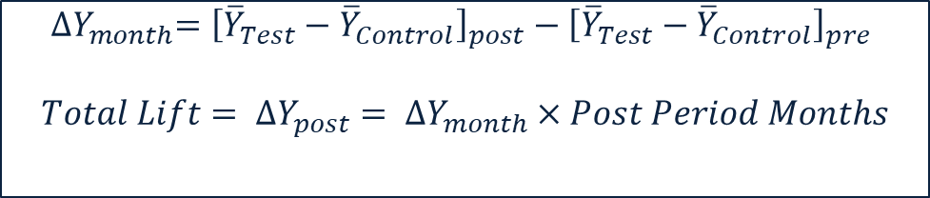
Lift Calculations - Deltas
$${∆Y}_{month}={\left[{\overline{Y}}_{Test}−{\overline{Y}}_{Control}\right]}_{post}−{\left[{\overline{Y}}_{Test}−{\overline{Y}}_{Control}\right]}_{pre}$$
$${Total Lift= ∆Y}_{post}= {∆Y}_{month}×Post Period Months$$

Slide 20
Lift Calculations – Regression
Change in NRx = [Post_NRx – Pre_NRx]
[Post_NRx – Pre_NRx] = β×TC_Flag + α×Pre_NRx + a×Post_X1 + b×Post_X2 + c×Post_X3 + K
Through Regression, We are controlling for any post period changes in control variables and then estimating the actual estimate of the Test Lift
Here β represents the AVERAGE MOTHLY LIFT in NRx from Test Participants

Slide 21
Lift Calculations – Regression Results
Data for regression
Regression Results
[Post_NRx – Pre_NRx] = β×TC_Flag + α×Pre_NRx + K
[Post_NRx – Pre_NRx] = β×TC_Flag + K
Estimate here is same as Delta we got in previous slide

Slide 22
ROI Calculations
Total Incr. NRx = Estmiated Incr. NRx per Month x Number of Post Period Months x Number of Test Physicians
Incr. NRx = 9.12 * 6 * 2 = 109.4
Incr.NRx per month estimate is from Regression output.
Return on Investment (ROI) = Total. Incr. NRx / Promotion Spend

Slide 23
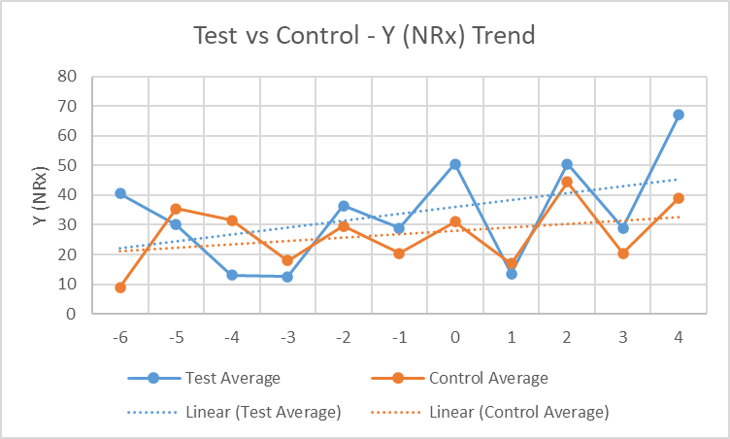
Charts and Outputs – Test vs Control Trend in Y (NRx)

Slide 24
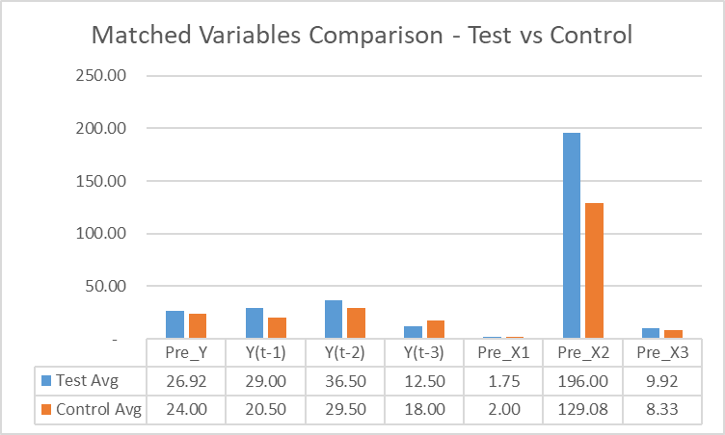
Charts and Outputs – Check Quality of Match Variables
Close to 0% is ideal

Slide 25
One to One Matching of Test and Controls
SAS Code Example

Slide 26
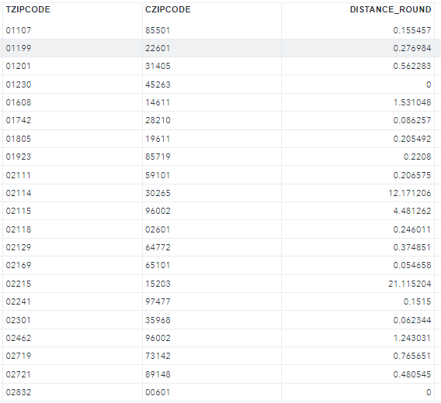
FASTCLUS in SAS
FASTCLUS is SAS procedure used for the clustering analysis. This procedure displays a cluster summary, giving the following for each cluster:
Cluster number, the number of observations in the cluster, maximum distance from seed to observation, the maximum distance from the cluster seed to any observation in the cluster
PROC FASTCLUS
DATA=STDCAND
MAXC=N_TEST
MAXITER=0
OUT=RESULT
SEED=STDTEST;
ODS OUTPUT INITIALSEEDS=INITIAL;
VAR SALES_L6M SALES_L5M SALES_L4M
SALES_L3M SALES_L2M SALES_L1M
CALLS_L6M
MMF_L6M
EM_ENGAGED_L6M
ALERTS_ENGAGED_L6M;
RUN;

Slide 27
REGRESSION
Regression model is run based on the matched test and control pair universe with post sales as dependent variables and post variables as independent variables
PROC REG DATA= DATA OUTEST=OUT_MOD;
MODEL: SALES_POST_12M = SALES_PRE_12M
CALLS_POST_12M MMF_POST_12M EM_ENGAGED_POST_L12M ALERTS_ENGAGED_POST_L12M
TEST_FLAG/VIF;
ID ZIP_CD;
PLOT / RIDGEPLOT NOMODEL NOSTAT;
ODS OUTPUT OUTPUTSTATISTICS=OUTSTATS;
RUN;
Impact (%) – Estimate * # Tests*12 /Total 12 Month Sales

Slide 28
Test & Control Datazymes Tool Demo
Januvia Virtual Sales Force Impact

